Slide 1
Entropy, Conditional entropy, Specific conditional entropy

Slide 2
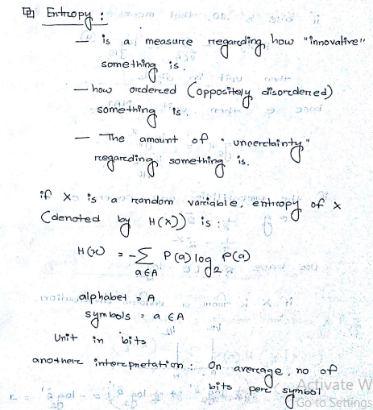
Entropy

Slide 3
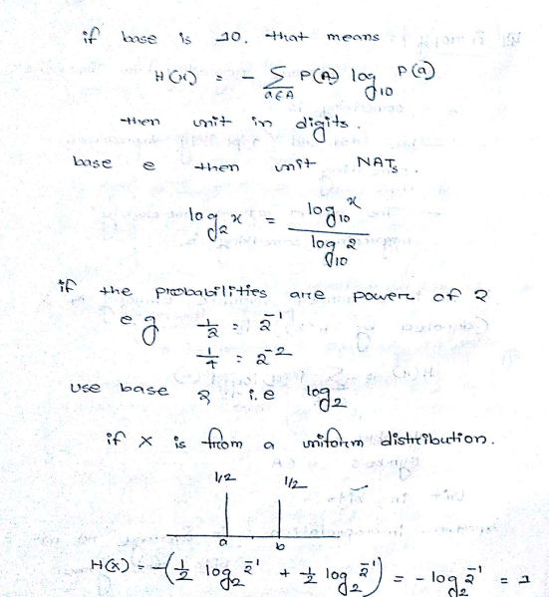
Entropy(Cont.)

Slide 4
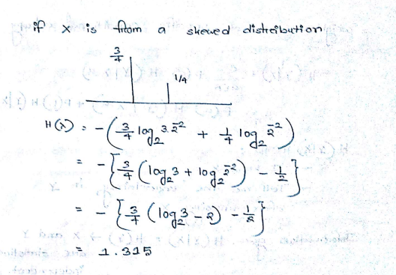
Entropy(Cont.)

Slide 5
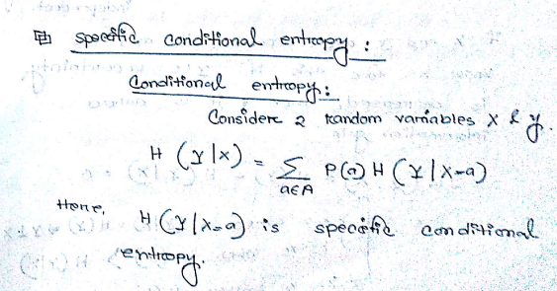
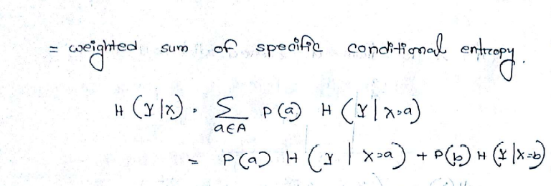
Conditional entropy and Specific conditional entropy

Slide 6
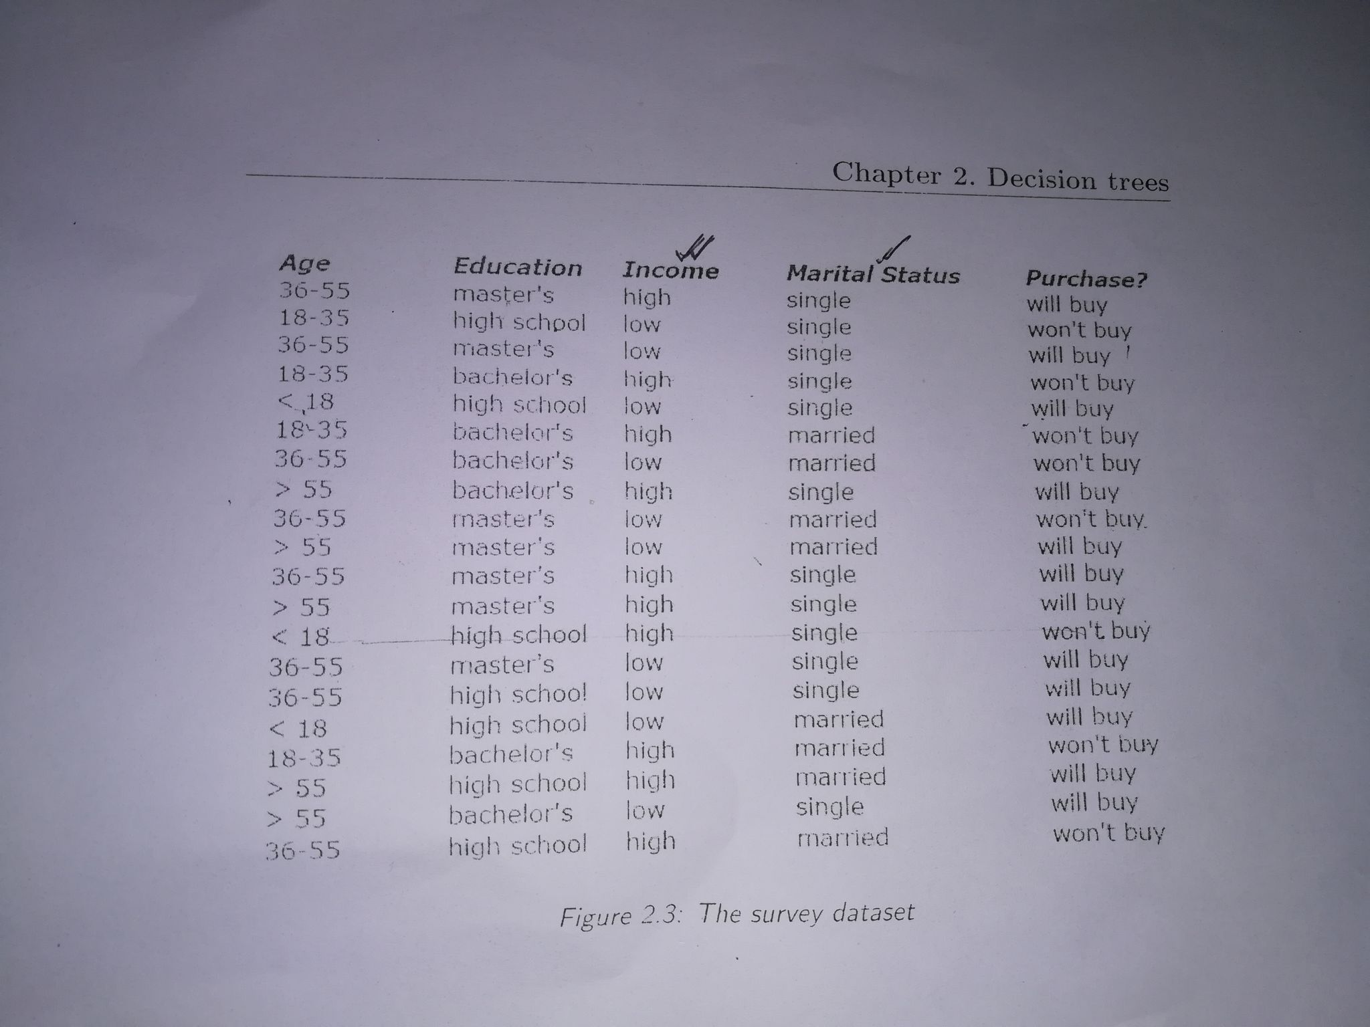
Conditional entropy and Specific conditional entropy(Cont.)

Slide 7
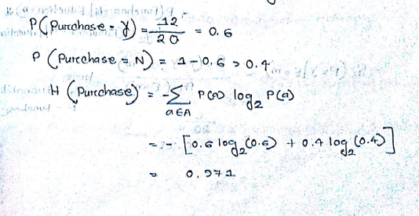
Conditional entropy and Specific conditional entropy(Cont.)

Slide 8
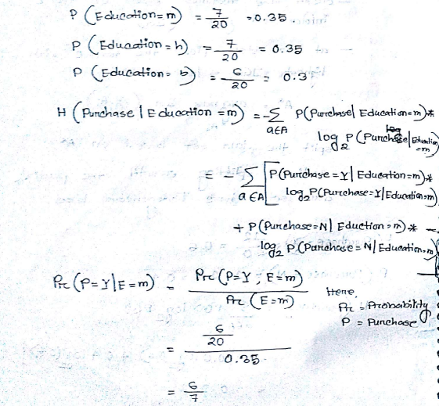
Conditional entropy and Specific conditional entropy(Cont.)

Slide 9
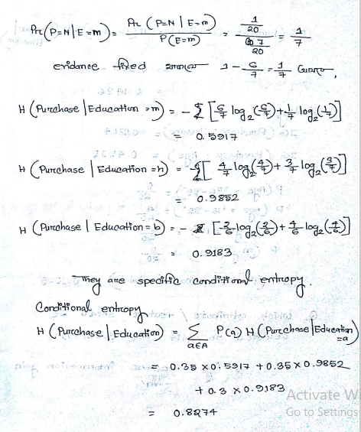
Conditional entropy and Specific conditional entropy(Cont.)

Slide 10
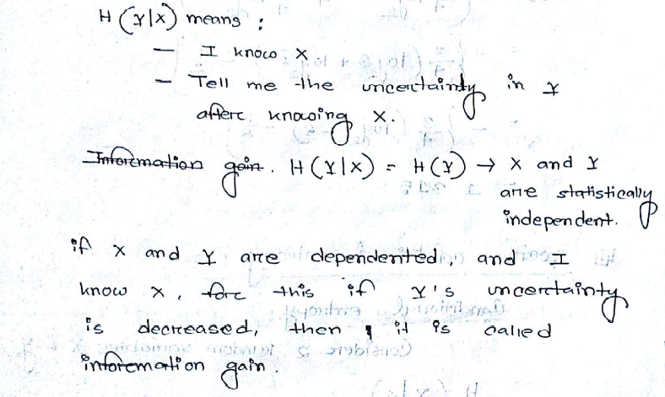
Conditional entropy and Specific conditional entropy(Cont.)

Slide 11
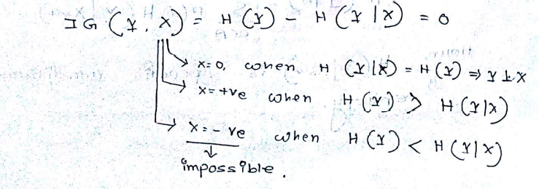
Conditional entropy and Specific conditional entropy(Cont.)

